Slide 1
Entity framework orm
Avinash thorat
DECEMBER 19, 2022

Slide 2
Agenda
Working of Entity Framework
ORM
Features
Approaches
Querying
Compare Ef with EF Core
When to use EF core
Tutorial
How to specify relationships – annotations, configurations
Inheritance in EF
Tracked vs non tracked entities
Conclusion.

Slide 3
Entity framework – overview and Working

Slide 4
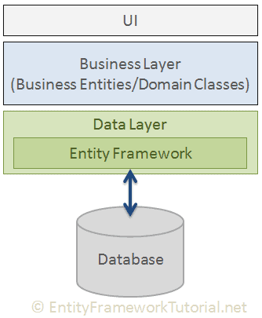
Entity framework
Earlier we used to write ADO.NET code.
Entity Framework is an Object Relational Mapper that has been developed by Microsoft.
to work with the database in .NET applications using .NET objects.
It takes care of establishing a connection to the database and also helps to manipulate databases by allowing the creation of objects and gives us methods to work with the data.
The Entity Framework API is used to perform all the database related operations which map all operations to the database.

Slide 5
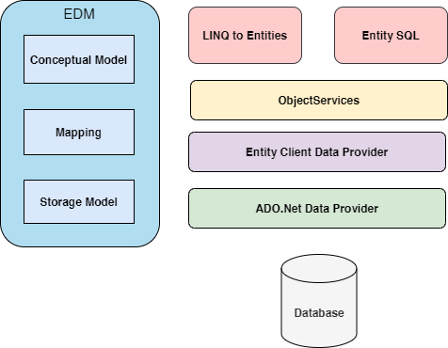
Working of EF
The Entity Framework Architecture Components are as follows:
EDM (Entity Data Model) – It is composed of three main parts – Conceptual Model, Mapping, and the Storage Model.
Conceptual Model – It is independent of the database table design and consists of the model classes and their relationships.
Mapping – It contains information regarding the mapping between the storage model and the conceptual model.
Storage Model – It is the database design model and includes tables and other database components.
LINQ to Entities – It is a query language that enables us to write queries against the object model and return entities.
Entity SQL (EF 6 only) – It is a query language just like LINQ to Entities.
Object Service – It is the main entry point that allows accessing data from the database. It helps to convert data returned from an entity client data provider to an entity object structure.
Entity Client Data Provider – The main role is to convert LINQ to Entities or Entity SQL queries to SQL queries so that they can be understood by the existing database. It is responsible for communicating with the ADO.Net data provider.
ADO.Net Data Provider – This is responsible for communicating with the database using standard ADO.Net.

Slide 6
ORM

Slide 7
Object Relational Mapping (ORM)
You can see the ORM as the layer that connects object oriented programming (OOP) to relational databases.
The ORM and ORM tools help simplify the interaction between relational databases and different OOP languages.
Advantages of Using ORM Tools
Here are some of the advantages of using an ORM tool:
It speeds up development time for teams.
Decreases the cost of development.
Handles the logic required to interact with databases.
Improves security. ORM tools are built to eliminate the possibility of SQL injection attacks.
You write less code when using ORM tools than with SQL.
Disadvantages of Using ORM Tools
Learning how to use ORM tools can be time consuming.
They are likely not going to perform better when very complex queries are involved.
ORMs are generally slower than using SQL.

Slide 8
features

Slide 9
Cross-platform: EF Core is a cross-platform framework which can run on Windows, Linux and Mac.
Modelling: EF (Entity Framework) creates an EDM (Entity Data Model) based on POCO (Plain Old CLR Object) entities with get/set properties of different data types. It uses this model when querying or saving entity data to the underlying database.
Querying: EF allows us to use LINQ queries (C#/VB.NET) to retrieve data from the underlying database. The database provider will translate this LINQ queries to the database-specific query language (e.g. SQL for a relational database). EF also allows us to execute raw SQL queries directly to the database.
Change Tracking: EF keeps track of changes occurred to instances of your entities (Property values) which need to be submitted to the database.
Saving: EF executes INSERT, UPDATE, and DELETE commands to the database based on the changes occurred to your entities when you call the SaveChanges() method. EF also provides the asynchronous SaveChangesAsync() method.
Concurrency: EF uses Optimistic Concurrency by default to protect overwriting changes made by another user since data was fetched from the database.
Transactions: EF performs automatic transaction management while querying or saving data. It also provides options to customize transaction management.
Caching: EF includes first level of caching out of the box. So, repeated querying will return data from the cache instead of hitting the database.
Built-in Conventions: EF follows conventions over the configuration programming pattern, and includes a set of default rules which automatically configure the EF model.
Configurations: EF allows us to configure the EF model by using data annotation attributes or Fluent API to override default conventions. (Required, Display Name, Range etc)
Migrations: EF provides a set of migration commands that can be executed on the NuGet Package Manager Console or
the Command Line Interface to create or manage underlying database Schema.

Slide 10
Concurrency
In most scenarios, databases are used concurrently by multiple application instances, each performing modifications to data independently of each other. When the same data gets modified at the same time, inconsistencies and data corruption can occur.
Optimistic and Pessimistic concurrency
EF Core implements optimistic concurrency, which assumes that concurrency conflicts are relatively rare. optimistic concurrency takes no locks, but arranges for the data modification to fail on save if the data has changed since it was queried. This concurrency failure is reported to the application, which deals with it accordingly, possibly by retrying the entire operation on the new data.
The concurrency token is loaded and tracked when an entity is queried - just like any other property. Then, when an update or delete operation is performed during SaveChanges(), the value of the concurrency token on the database is compared against the original value read by EF Core.
Example UPDATE [People] SET [FirstName] = @p0 WHERE [PersonId] = @p1 AND [Version] = @p2;

Slide 11
approaches

Slide 12
Entity framework approaches
CODE FIRST
This kind of approach prioritizes the creation of a database rather than working on an existing database. It helps to create a new database and creates a possibility of changing the configuration of a database upon changing the classes. It enables the developers to get more control through the code only.
DATABASE FIRST
This approach focuses on the creation of a database first before writing code or creation of classes. In this approach, we create databases and design the tables first. Once the database is set up, we can work on the existing database using code and creation of objects. The database is updated manually and the classes are generated according to the structure of the database. The classes are updated automatically upon the manual update of the database.
Model First

Slide 13
querying

Slide 14
Different Approaches for Querying
In Entity Framework, you can build and execute queries in three different ways to fetch the data from the underlying database. They are as follows:
LINQ-to-Entities
var student = (from std in context.Students
where std.StudentId == 1
select std).FirstOrDefault();
Entity SQL
string sqlString = "SELECT VALUE st FROM EF_Demo_DBEntities.Students " +
"AS st WHERE st.StudentId == 1";
var objctx = (context as IObjectContextAdapter).ObjectContext;
Student Object Context = objctx.CreateQuery<Student>(sqlString).FirstOrDefault();
Native SQL
var studentList = context.Students
.SqlQuery("Select * from Student")
.ToList<Student>();

Slide 15
Ef vs ef core

Slide 16
EF and EF core
EF6 is a stable, supported product, but is no longer being actively developed.
Designed for .NET Core. Integrates well with other parts of .NET Core, such as ASP.NET Core.
Most of the CRUD operations like read, write, delete etc. well performed compare to EF 6 by EF core.
https://learn.microsoft.com/en-us/ef/efcore-and-ef6/

Slide 17
Using ef core
EF core doesn’t have all the same features as EF 6.
If you want to use something specific which is not present in EF 6 then check the documentation of EF core.
Missing in EF Core | New features offered
Spatial data types (geography, geometry data) | Mapped types with no keys
Complex type mapping (table per type) | Property value conversions
Model first approach | Shadow state properties
High performance data access | Global query filters
 | Raw SQL queries: Composing with LINQ

Slide 18
Annotations and configurations

Slide 19
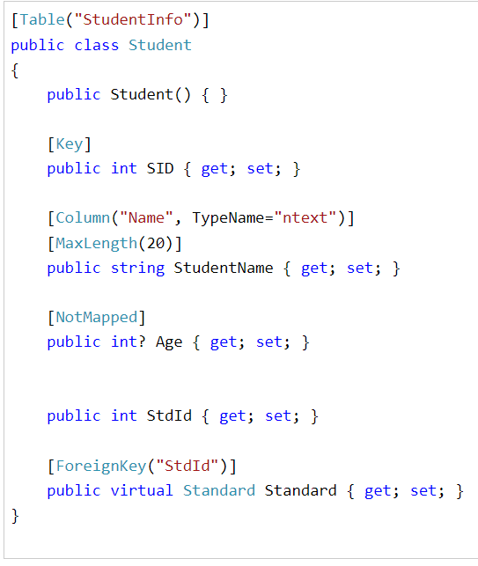
Configuration and data annotation
DataAnnotations is used to configure the classes which will highlight the most commonly needed configurations. DataAnnotation attributes override default CodeFirst conventions.
Now let’s suppose Student class used the name StdntID instead of ID. When Code First does not find a property that matches this convention, it will throw an exception because of Entity Framework’s requirement that you must have a key property. You can use the key annotation to specify which property is to be used as the EntityKey.
Many times we want to customize the entity to table mapping and do not want to follow default conventions. EF Core allows us to configure domain classes in order to customize the EF model to database mappings. This programming pattern is referred to as Convention over Configuration.
There are two ways to configure domain classes in EF Core (same as in EF 6).
By using Data Annotation Attributes
By using Fluent API

Slide 20
Fluent api
Another way to configure domain classes is by using Entity Framework Fluent API. Entity Framework Fluent API is used to configure domain classes to override conventions.
the ModelBuilder class acts as a Fluent API.
Entity Framework Core Fluent API configures the following aspects of a model:
Model Configuration: Configures an EF model to database mappings. Configures the default Schema, DB functions, additional data annotation attributes and entities to be excluded from mapping.
Entity Configuration: Configures entity to table and relationships mapping e.g. PrimaryKey, AlternateKey, Index, table name, one-to-one, one-to-many, many-to-many relationships etc.
Property Configuration: Configures property to column mapping e.g. column name, default value, nullability, Foreignkey, data type, concurrency column etc.
Example - Override the OnModelCreating method and use
a parameter modelBuilder of
type ModelBuilder to configure domain classes.
public class SchoolDBContext: DbContext
{
public DbSet<Student> Students { get; set; }
protected override void OnModelCreating(ModelBuilder modelBuilder)
{
//Write Fluent API configurations here
//Property Configurations
modelBuilder.Entity<Student>()
.Property(s => s.StudentId)
.HasColumnName("Id")
.HasDefaultValue(0)
.IsRequired();
}
}

Slide 21
Inheritance in EF

Slide 22
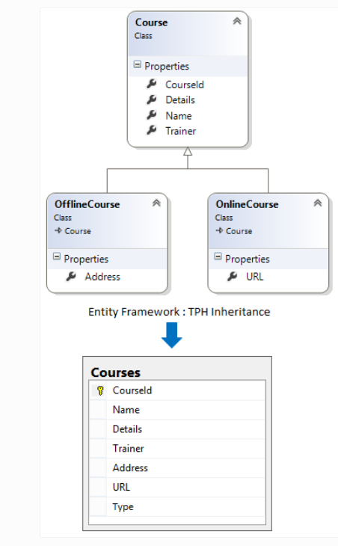
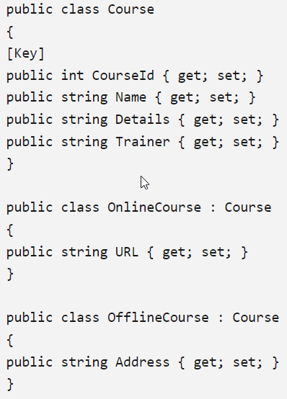
EF with inheritance
This is like classes in C#. You can map an inheritance hierarchy to single or multiple DB tables based on your requirements.
Table per hierarchy - There is only one table in database and different Entity types in Entity model that inherits from a base Entity are mapped to that table.

Slide 23
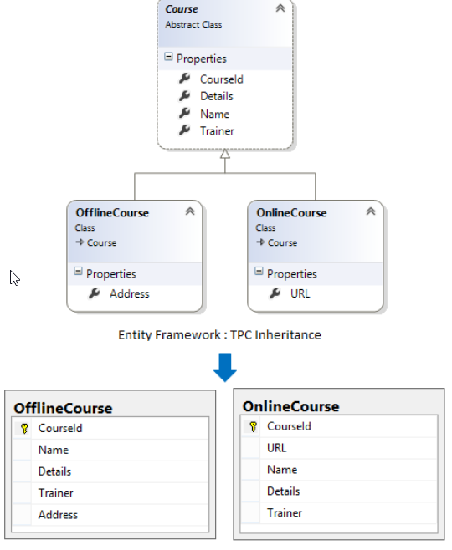
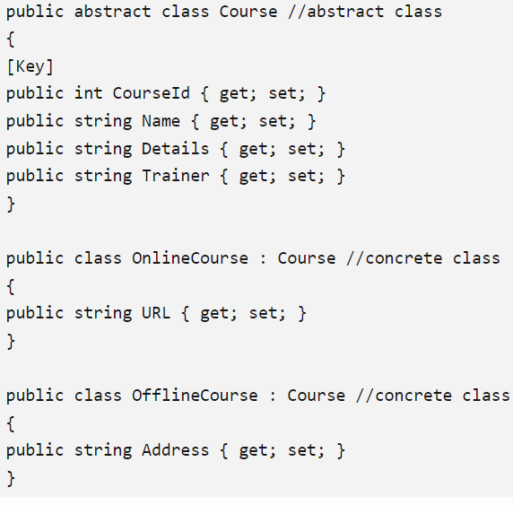
Table per concrete type
Each concrete class (a class which can be instantiated) in the hierarchy of entities is mapped to a separate table in storage schema. It means, there is separate table in database to maintain data for each derived entity type.

Slide 24
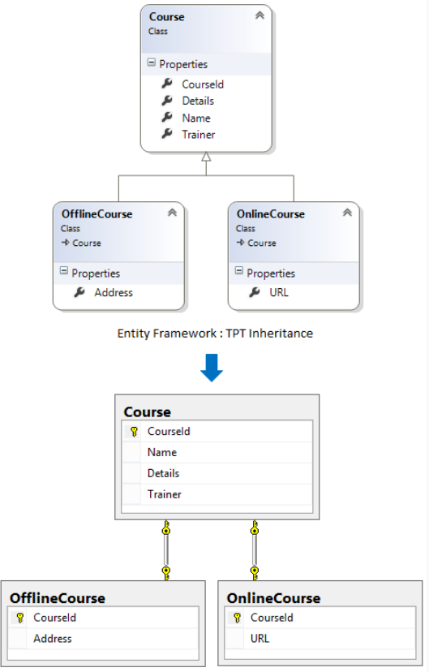
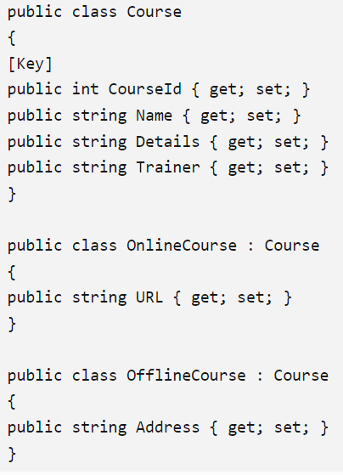
Table per type
Each entity in the hierarchy of entities is mapped to a separate table in storage schema. It means, there is separate table in database to maintain data for each Entity Type.

Slide 25
Tracked vs non-tracked entities

Slide 26
Tracking vs. No-Tracking Queries
keep information about an entity instance in its change tracker.
Key less entities are never tracked.
Tracking
By default, queries that return entity types are tracking. Which means you can make changes to those entity instances and have those changes persisted by SaveChanges().
EF always checked if the results returned by a query is already present in context, if it found, it return same instance. If not found, new instance get created and EF bound it to context.
No-Tracking Queries
No tracking queries are useful when the results are used in a read-only scenario. They're quicker to execute because there's no need to set up the change tracking information. AsNoTracking().

Slide 27
Conclusion
Entity Framework helps to reduce development time and development cost.
It provides auto-generated code and allows developers to visually design models and mapping of databases.
It allows easy mapping of Business Objects.
It helps to perform fast CRUD operations in .NET Applications.

